Slide 1
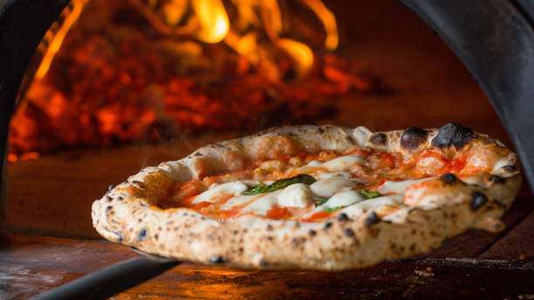
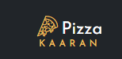
Pizza K A A R A N
By Py-Rates

Slide 2


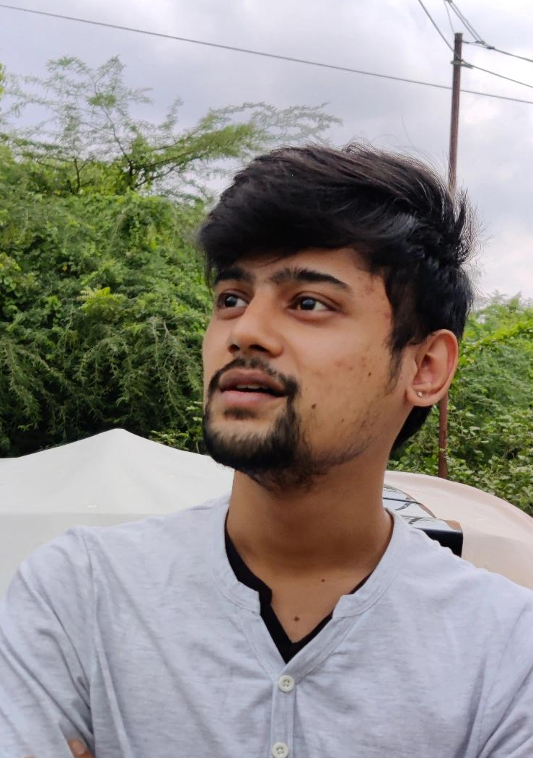

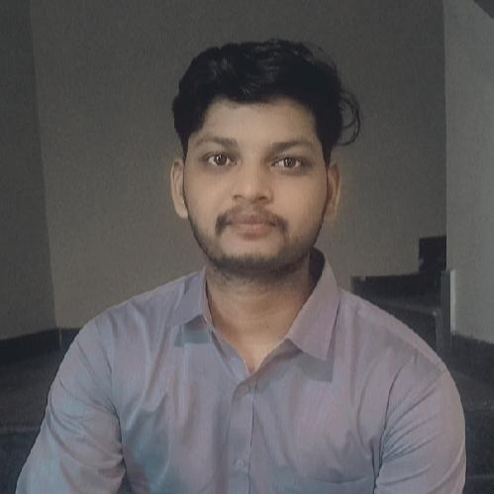
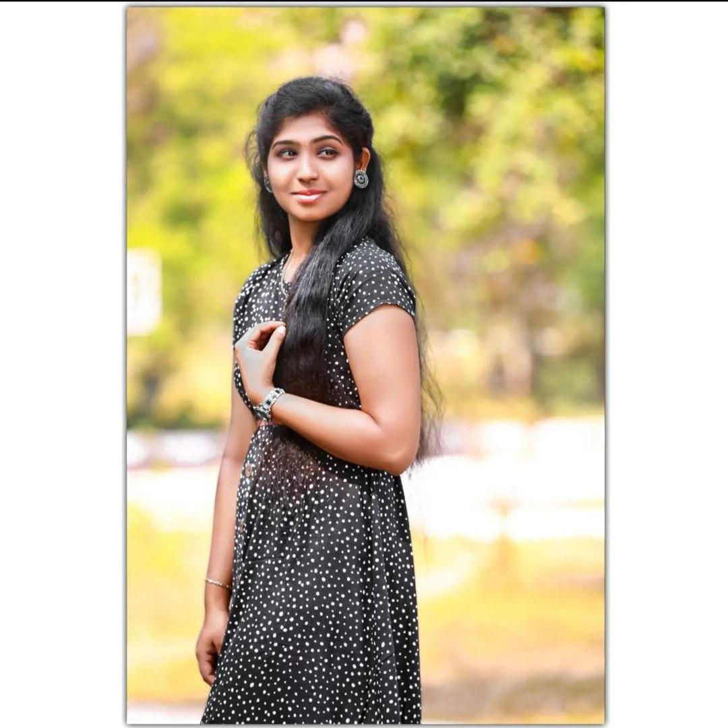
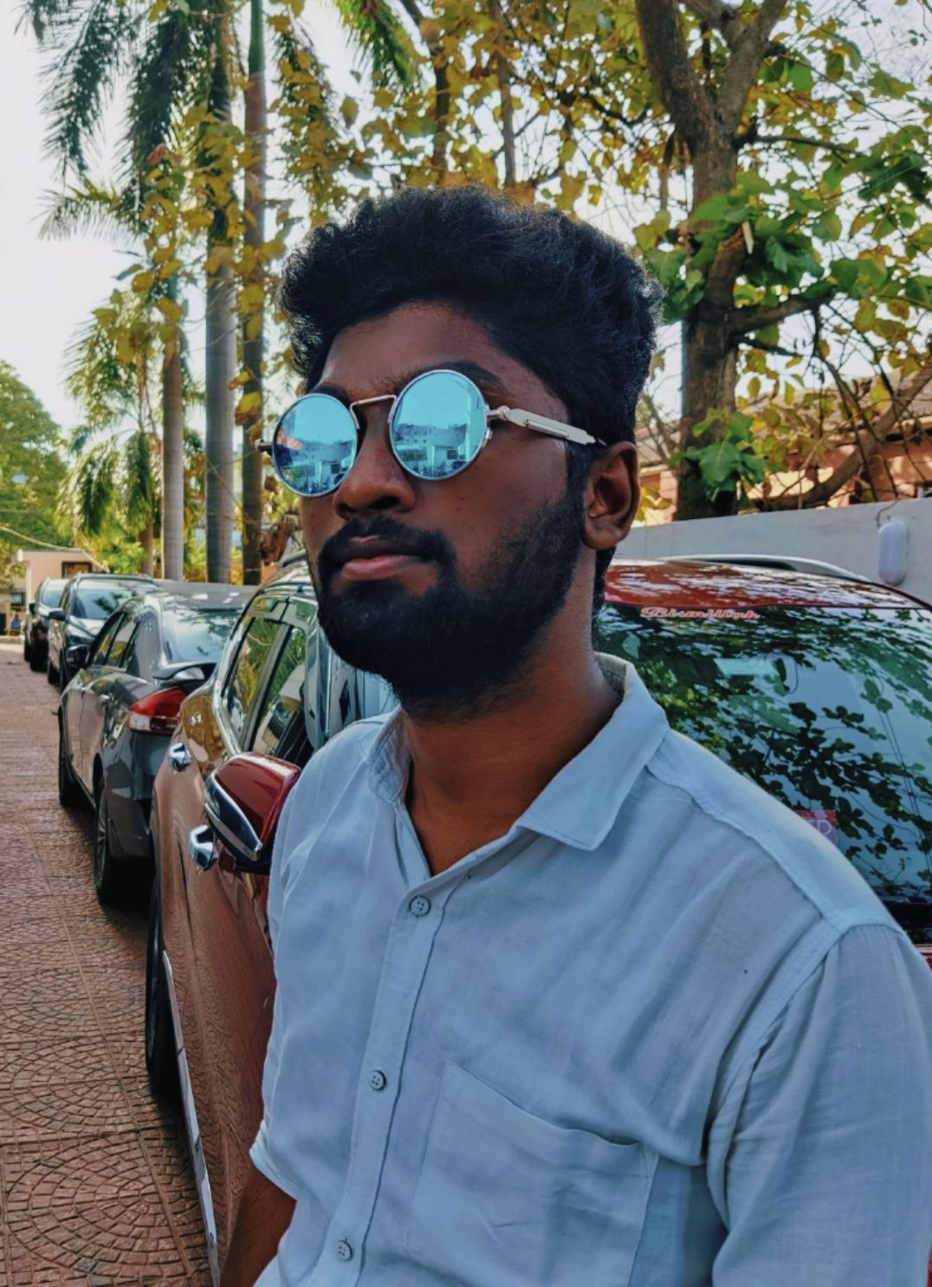
Team
--Vignesan--
Data Engineer
--Kishore--
Data Engineer
--Supriya--
Cloud Engineer
--Naveen--
Cloud Engineer
--Varun--
Cloud Engineer
--Ameena--
Python Full Stack

Slide 3

Agenda
INTRODUCTION
PROBLEM STATEMENT
SCOPE
OUT OF SCOPE
MODULES
CONCEPTS
ARCHITECTURAL DIAGRAM
ADMIN FLOW CHART
USER FLOW CHART
ENTITIES
DATABASE SCREENSHOT
USERFACE SCREENSHOT
THANK YOU

Slide 4

Introduction
The authentic Cloud Kitchen/ Restaurant Pizza Kaaran is used to order your favorite mouth-watering Pizzas, burgers, Fries and Beverages online in just a click.
This is especially designed for the people who are in rush hour or wants to save time and enjoy the meal comfortably in their space.
We make sure that we deliver the order "Hot" at your doorstep on time.
2 types of modules are used here – Admin and Customer.
All the orders are managed by the admin. The customers can make use of the offers and order their favorites.

Slide 5
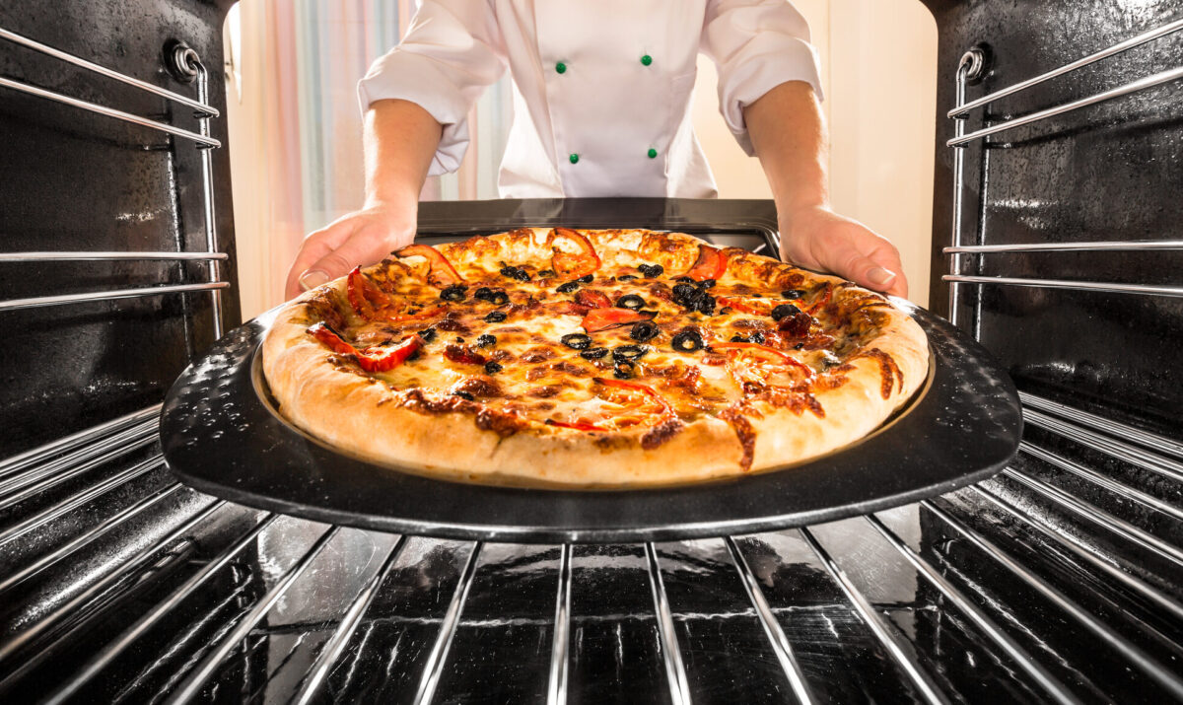
PROBLEM STATEMENT
In the existing system, there will be issues related to travel expenses, and travel to experience the taste.
Sometimes people might be uncomfortable to eat in a crowded ambience.
In these testing covid times, the customers sometimes tend to risk contact while ordering.
The pizza kaaran also aims to increase the sales, due to the easy to use order online website.
So, The focus is to create an “easy to use” website, which will allow a first time customer to complete their order with ease.

Slide 6
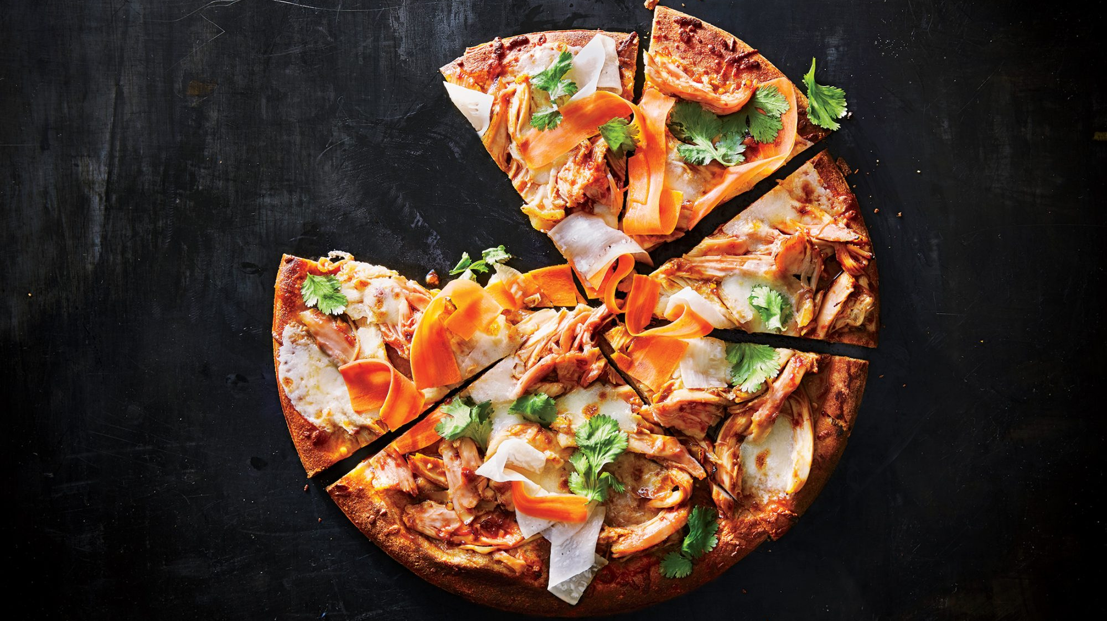
SCOPE
ADMIN :
Admin will be able to add, remove the items and update the offers.
Admin can store the details of the customers when they login to the portal.
CUSTOMERS:
The customers can access the portal by just logging in on the page.
They can order the combos when the offer is available to them.

Slide 7
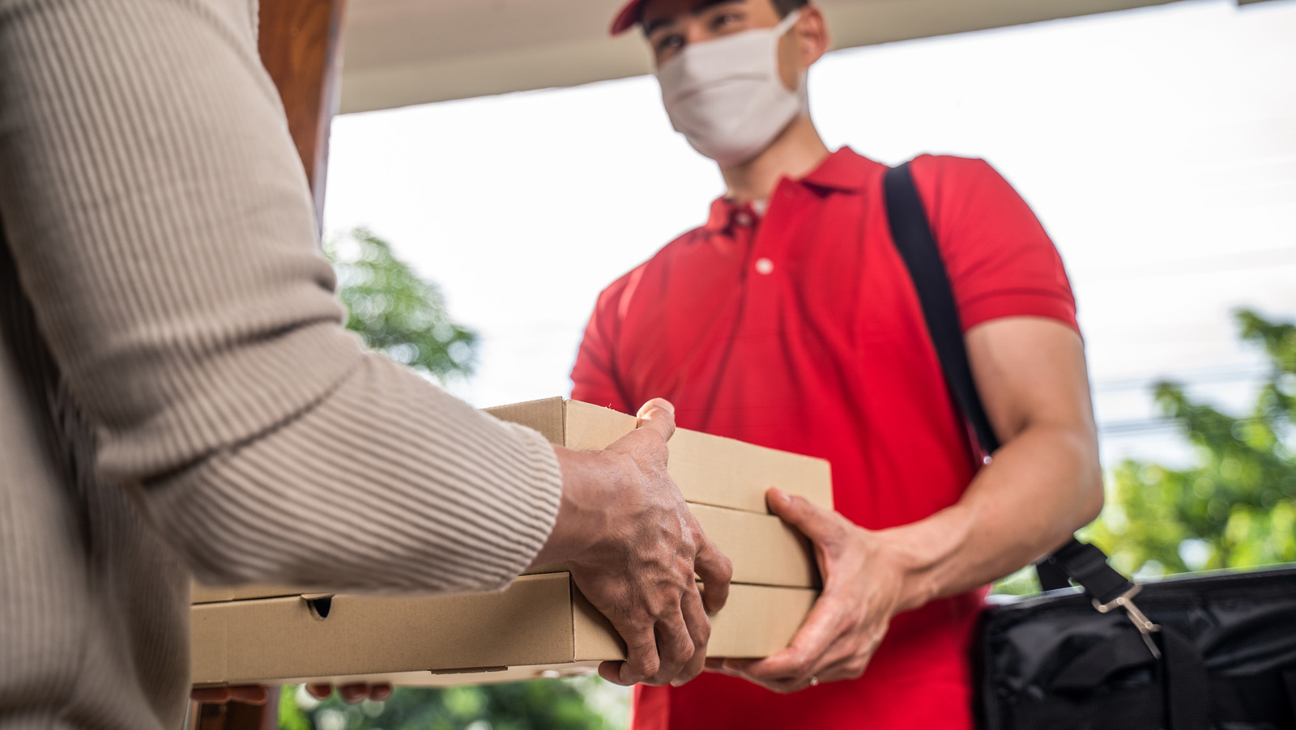
Out of scope
We didn't implement any tie ups with delivery partners.
Also we didn’t implement the online payment options as of now..

Slide 8
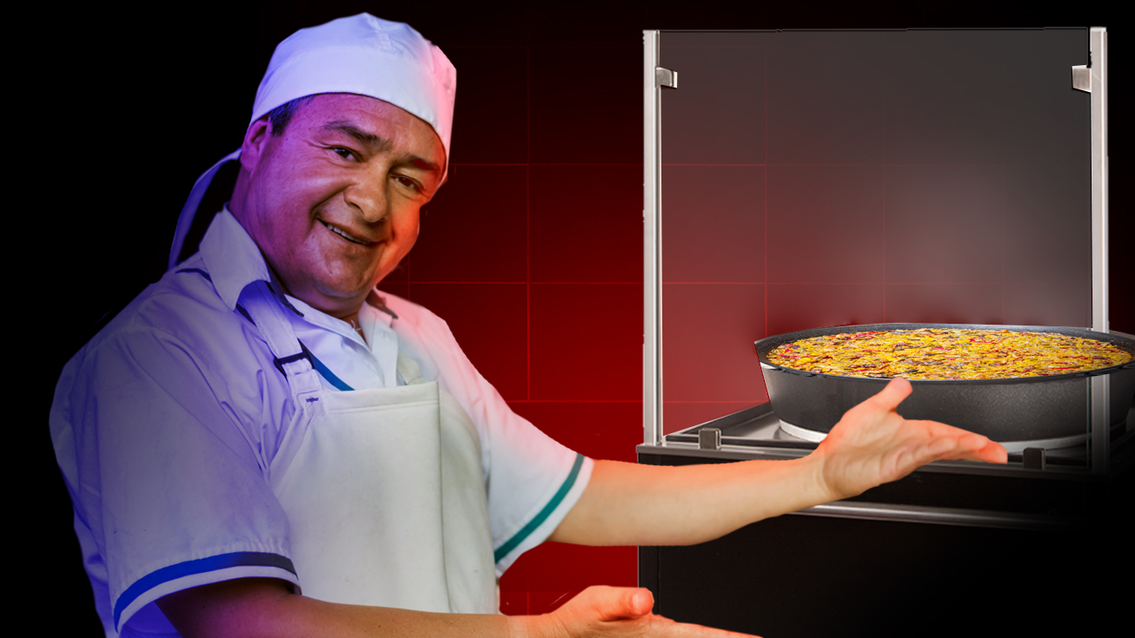
MODULES
Landing Page
Registration
Login
Dashboard
Add Items
Update Items
Remove Items
View Orders

Slide 9

CONCEPTS
Modules
Entities
Routers
Services
Bootstrap
Mysql Connector

Slide 10
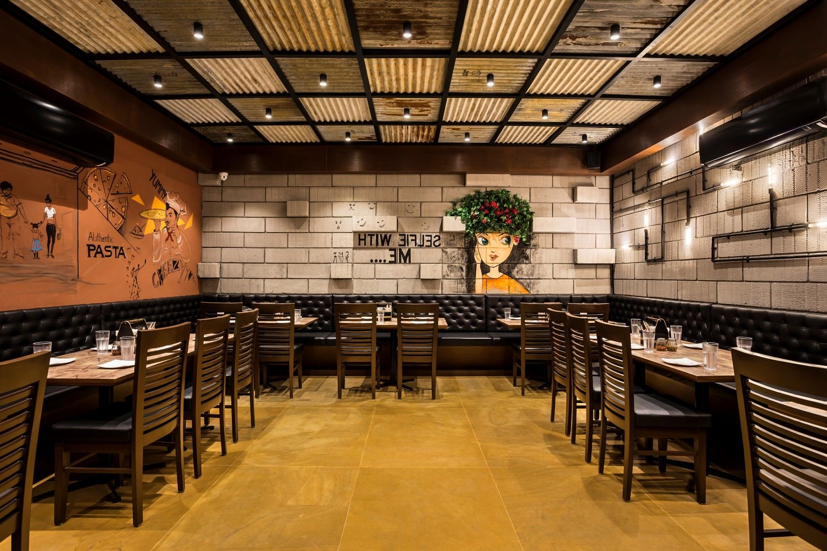



Architectural Diagram
What the user sees and interacts with..
PLACE
ORDER
REQUEST
CONFIRM ORDER
RESPONSE
CUSTOMER
Html, css, jinja2,bootstrap
MySQL DATABASE

Slide 11
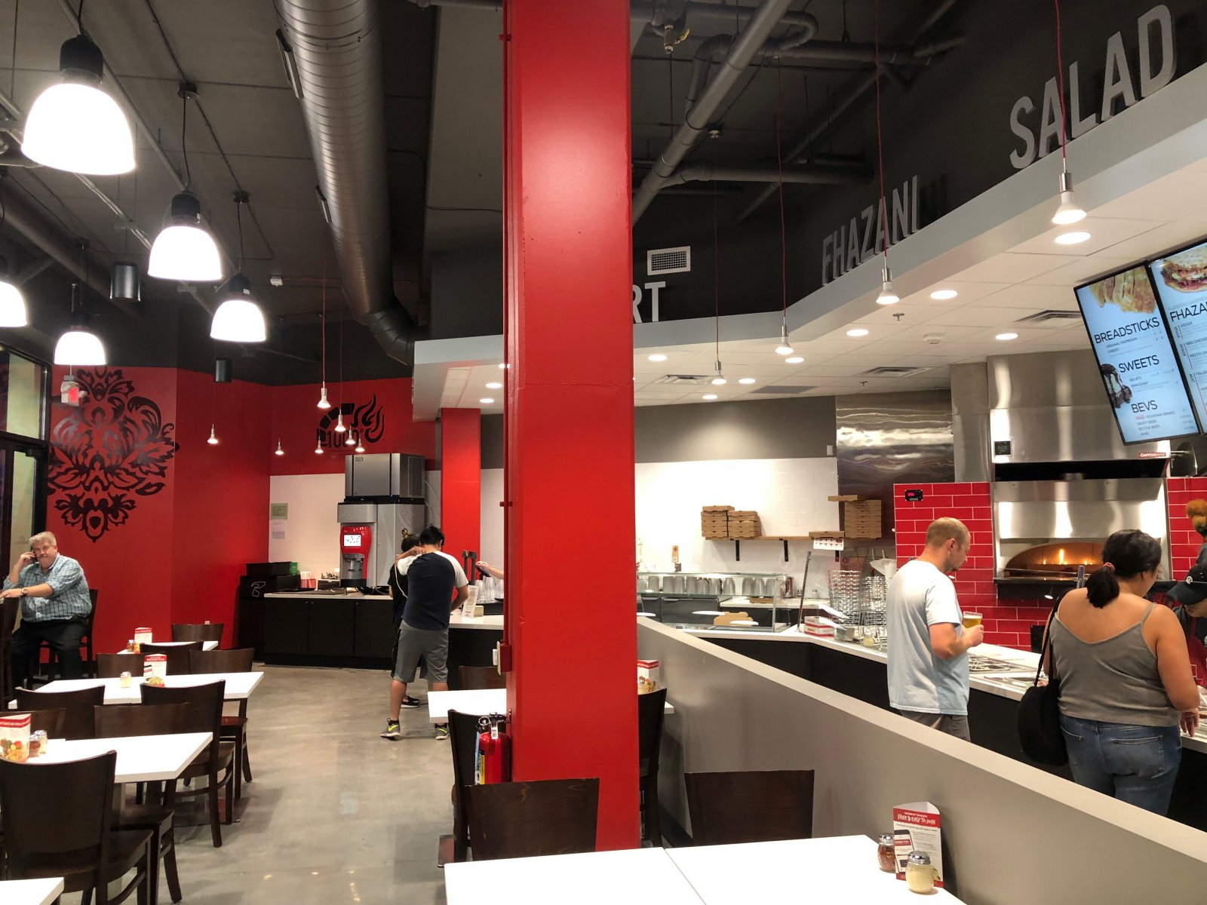
ADMIN FLOW CHART
Admin
Login
View Items
Orders
Add items
Edit Items
Remove Items
Confirm Orders

Slide 12
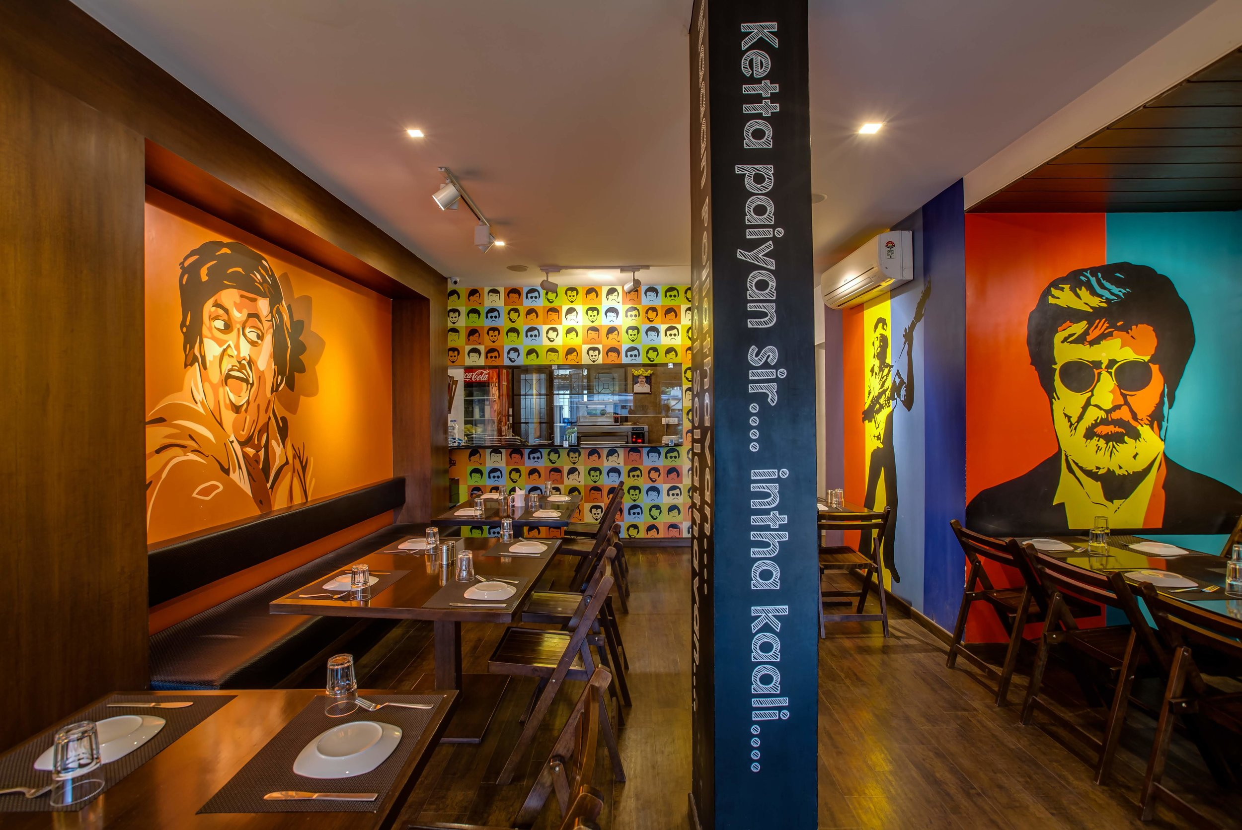
USER FLOW CHART
Customers
Register
Login
View Menu
Order

Slide 13
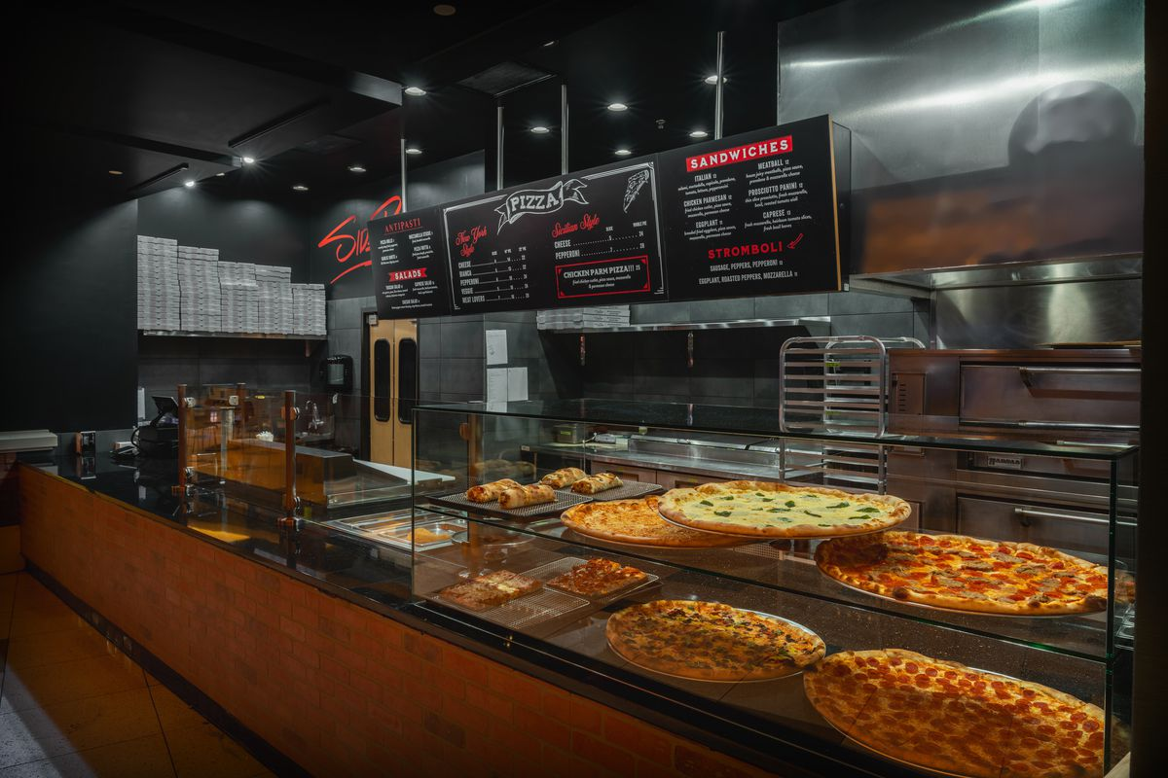
ENTITIES
ADMIN
REGISTERS
Username
(Varchar(50))
Password
(Varchar(50))
Firstname
(Varchar(50))
Lastname
(Varchar(50))
Email_id
(Varchar(50))
Mobile_no
(Number(50))
Password
(Password(50))
Address
(Textarea(100))

Slide 14
Burgeritems
Drinksitems
Pastaitems
Pizzaitems
Product_code
(Varchar(50))
Product_name
(Varchar(50))
Product_price
(Int(10))
Product_pic
(Varchar(100))
Product_code
(Varchar(50))
Product_name
(Varchar(50))
Product_price
(Int(10))
Product_pic
(Varchar(100))
Product_code
(Varchar(50))
Product_name
(Varchar(50))
Product_price
(Int(10))
Product_pic
(Varchar(100))
Product_code
(Varchar(30))
Product_name
(Varchar(30))
Product_price
(Int(0))
Product_pic
(Varchar(10))

Slide 15
ORDERS
ENQUIRY
SURVEY
Product_name
(Varchar(50))
username
(Varchar(50))
Email ((varchar(50))
Quantity
(Numeric)
Mobile_no
(varchar(50))
Orderdate(date)
Address
(varchar(100))
Price(int)
Totalcost(int)
Product_price
(Int(10))
Product_pic
(Varchar(100))
username
(Varchar(50))
Mobile_no
(varchar(20))
Email
(varchar(50))
Typeofproblem (varchar(100))
Message
(varchar(20))
username
(Varchar(50))
City
(varchar(50))
item
(varchar(50))
favday
(varchar(20))
Family
(int)
favmonth
(varchar(20))

Slide 16
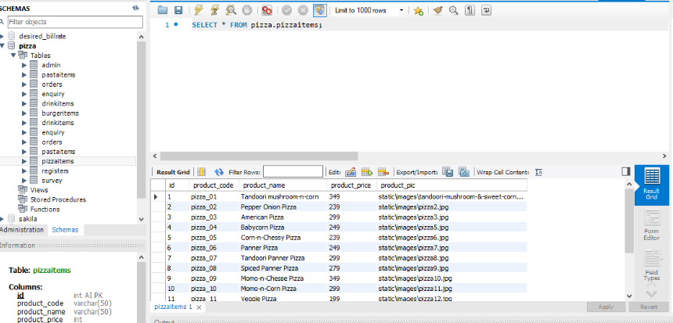
Database SCREENSHOTS
PIZZA ITEMS

Slide 17
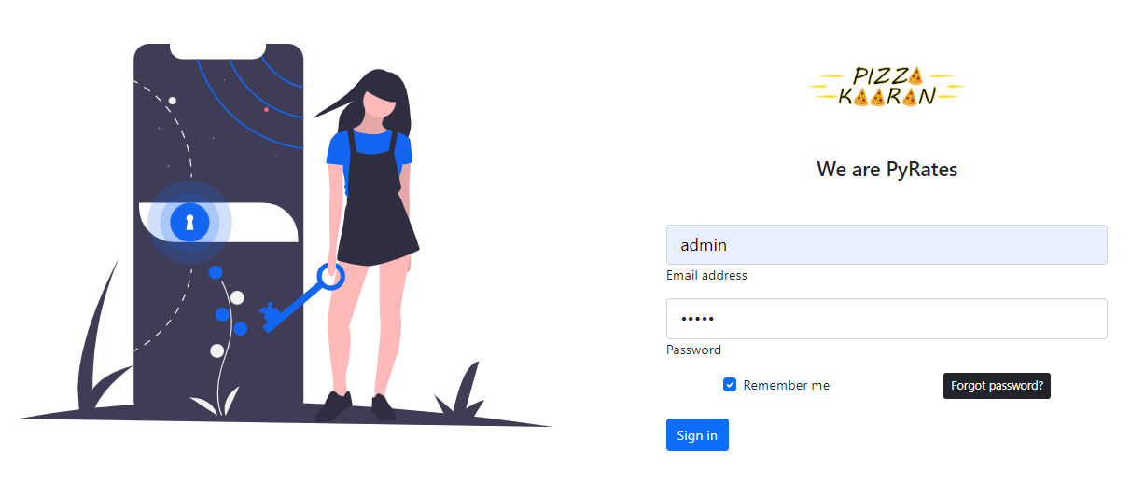
User Interface SCREENSHOTS
Admin Login

Slide 18
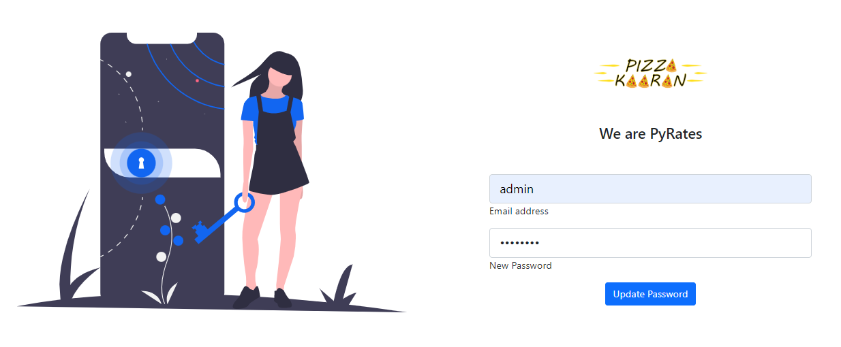
User Interface SCREENSHOTS
SCREENSHOTS
Admin Forgot Password

Slide 19
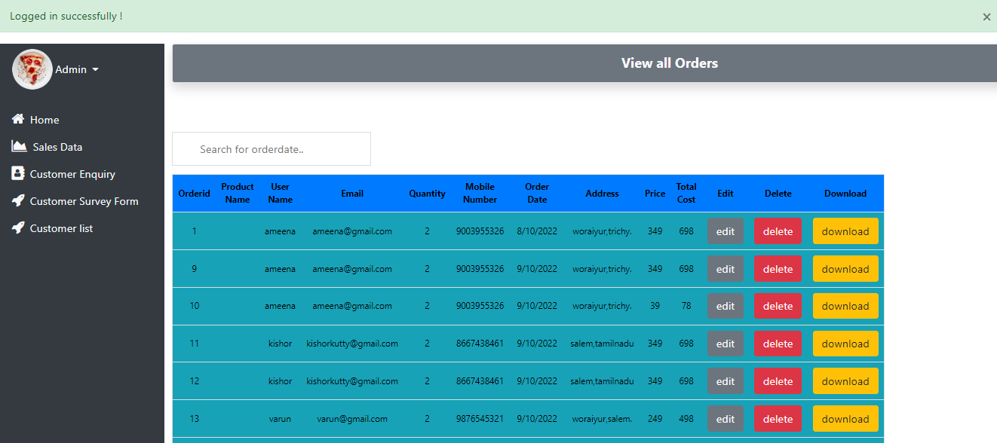
User Interface SCREENSHOTS
SCREENSHOTS
Admin Dashboard

Slide 20
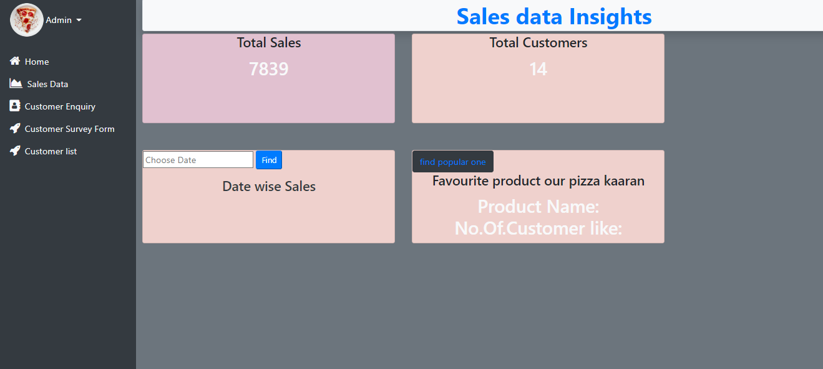
User Interface SCREENSHOTS
SCREENSHOTS
Admin SalesData Page

Slide 21
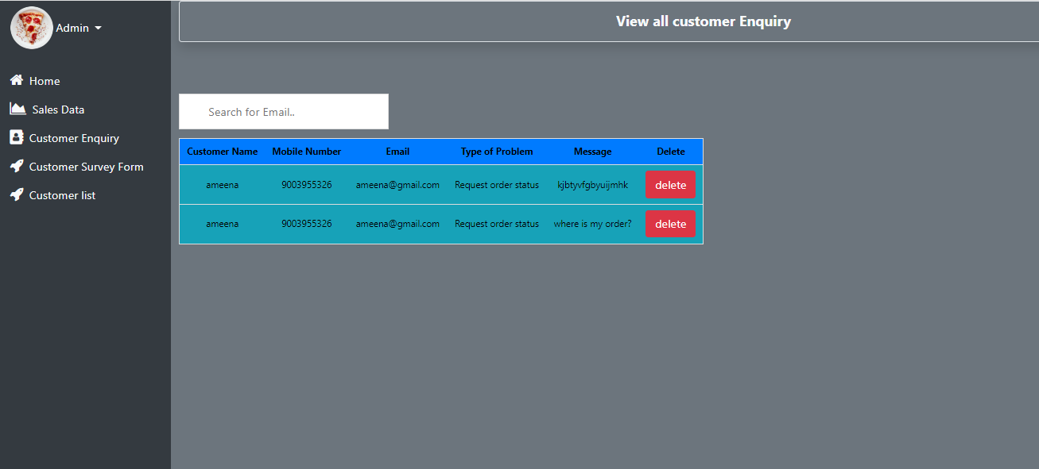
SCREENSHOTS
User Interface SCREENSHOTS
Admin Enquiry Page

Slide 22
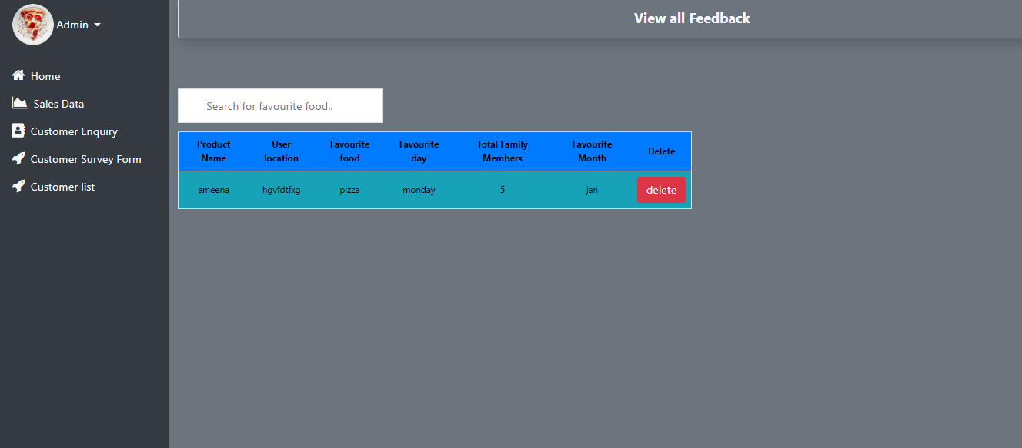
User Interface SCREENSHOTS
SCREENSHOTS
Admin Survey Page

Slide 23
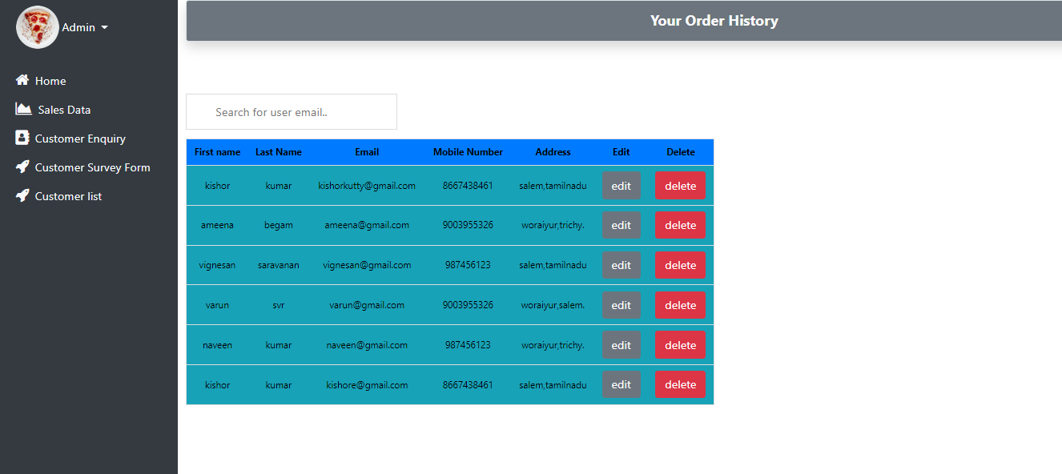
User Interface SCREENSHOTS
SCREENSHOTS
Admin CustomerList Page

Slide 24
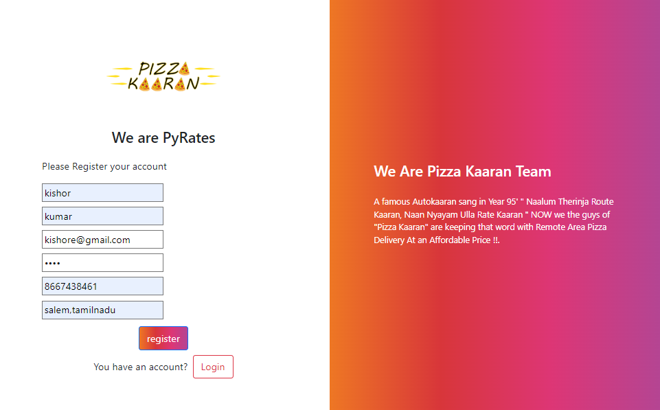
User Interface SCREENSHOTS
SCREENSHOTS
Registers

Slide 25
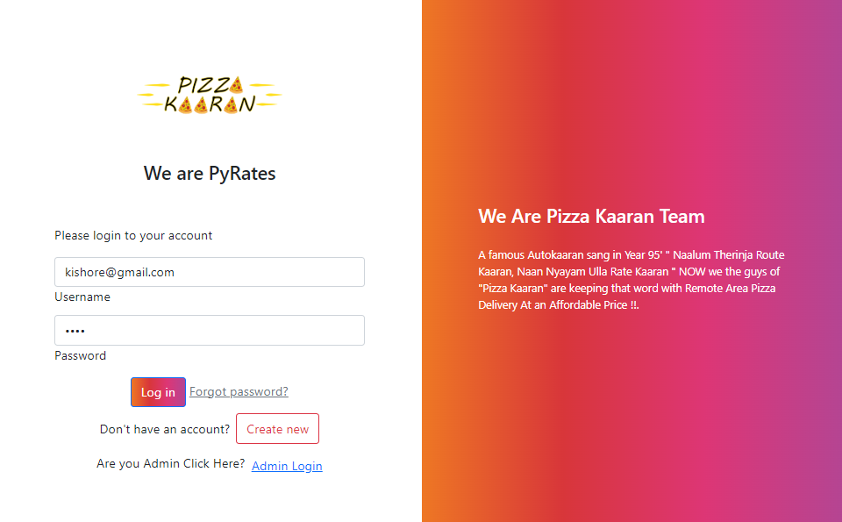
User Interface SCREENSHOTS
SCREENSHOTS
Userlogin

Slide 26
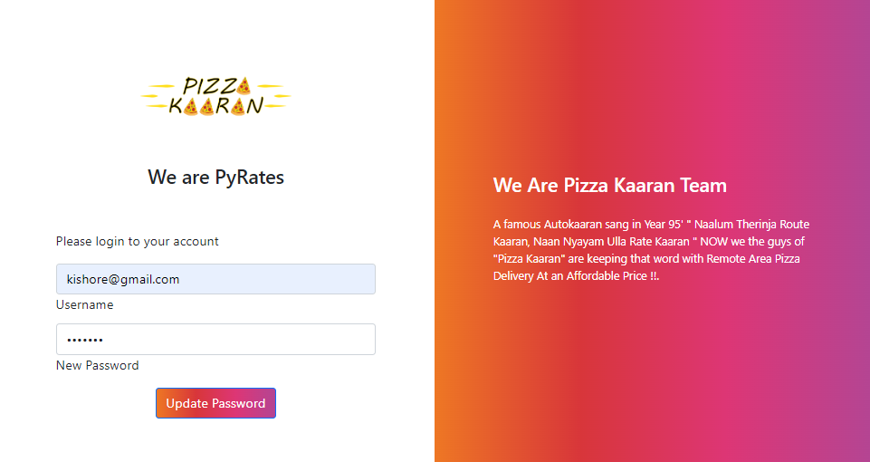
User Interface SCREENSHOTS
SCREENSHOTS
User Forgot Password

Slide 27
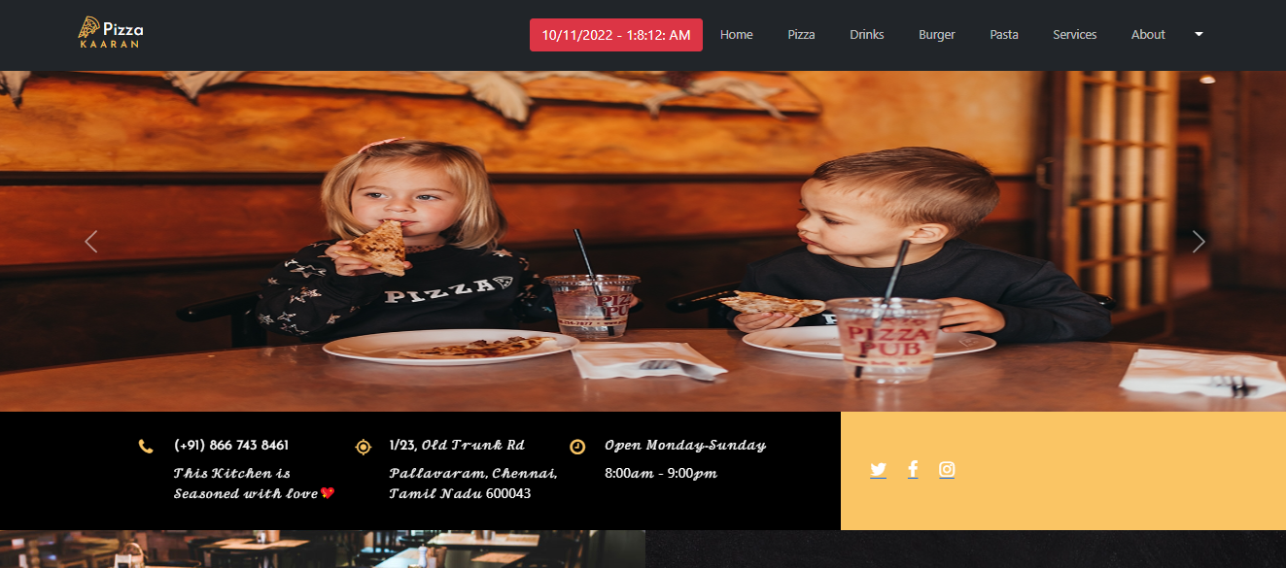
User Interface SCREENSHOTS
SCREENSHOTS
Home Page

Slide 28
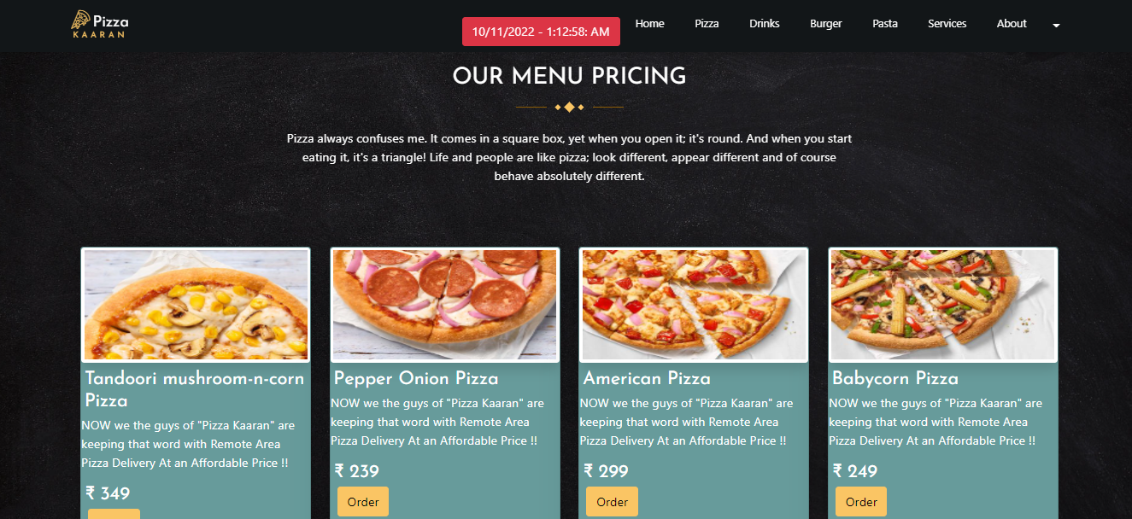
User Interface SCREENSHOTS
SCREENSHOTS
Pizza Page

Slide 29
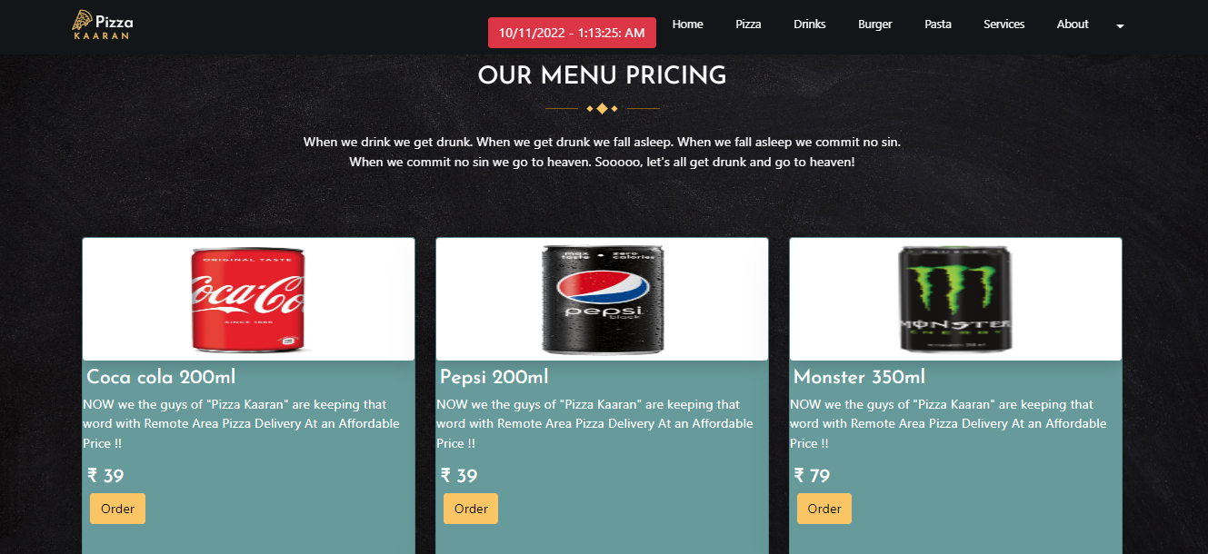
User Interface SCREENSHOTS
SCREENSHOTS
Drinks Page

Slide 30
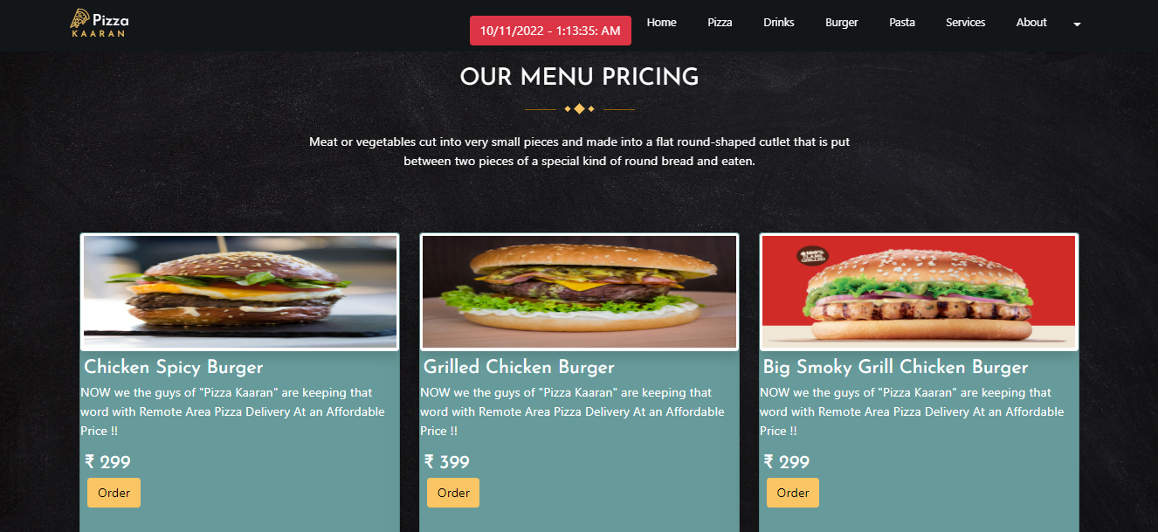
User Interface SCREENSHOTS
SCREENSHOTS
Burger Page

Slide 31
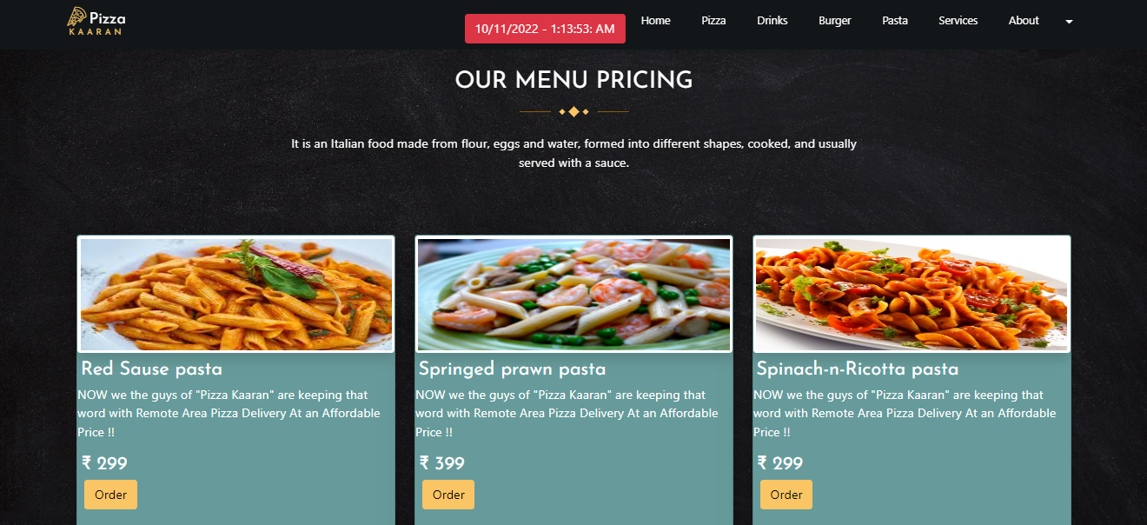
User Interface SCREENSHOTS
SCREENSHOTS
Pasta Page

Slide 32
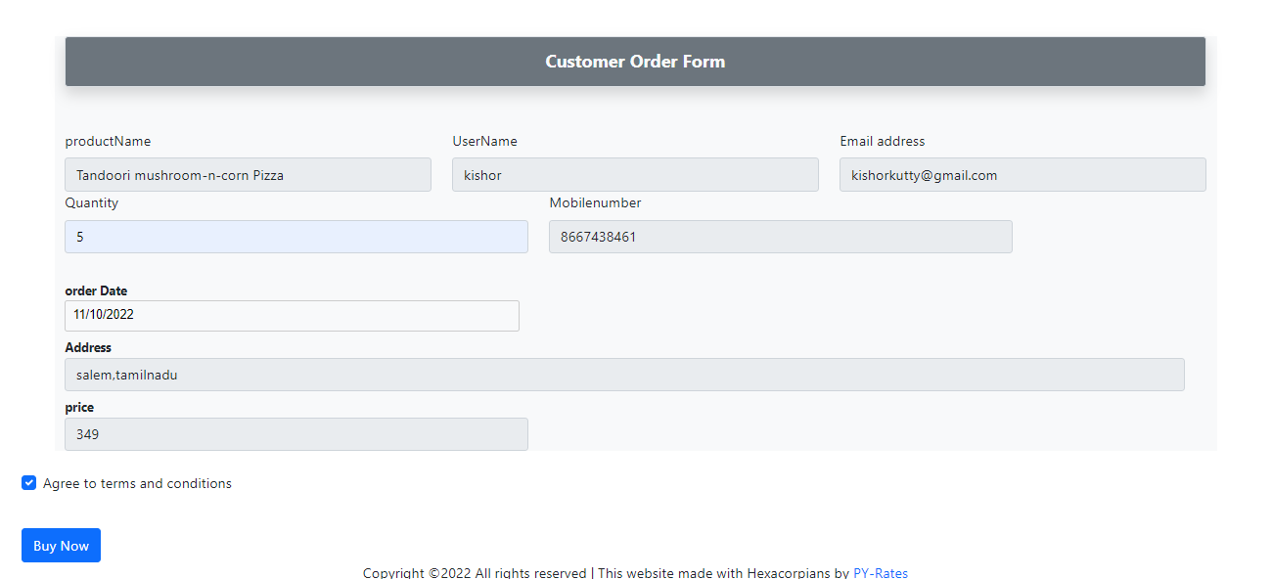
User Interface SCREENSHOTS
SCREENSHOTS
Order Form Page

Slide 33
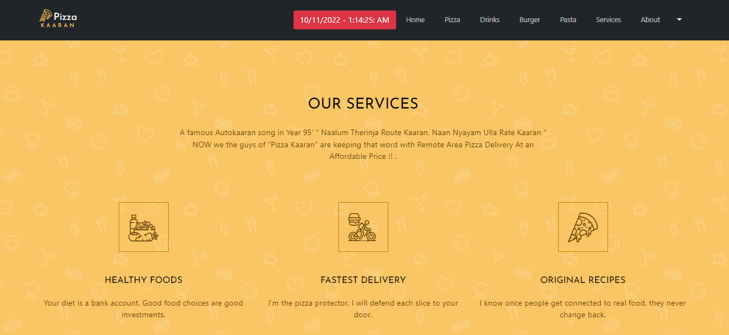
User Interface SCREENSHOTS
SCREENSHOTS
Service Page

Slide 34
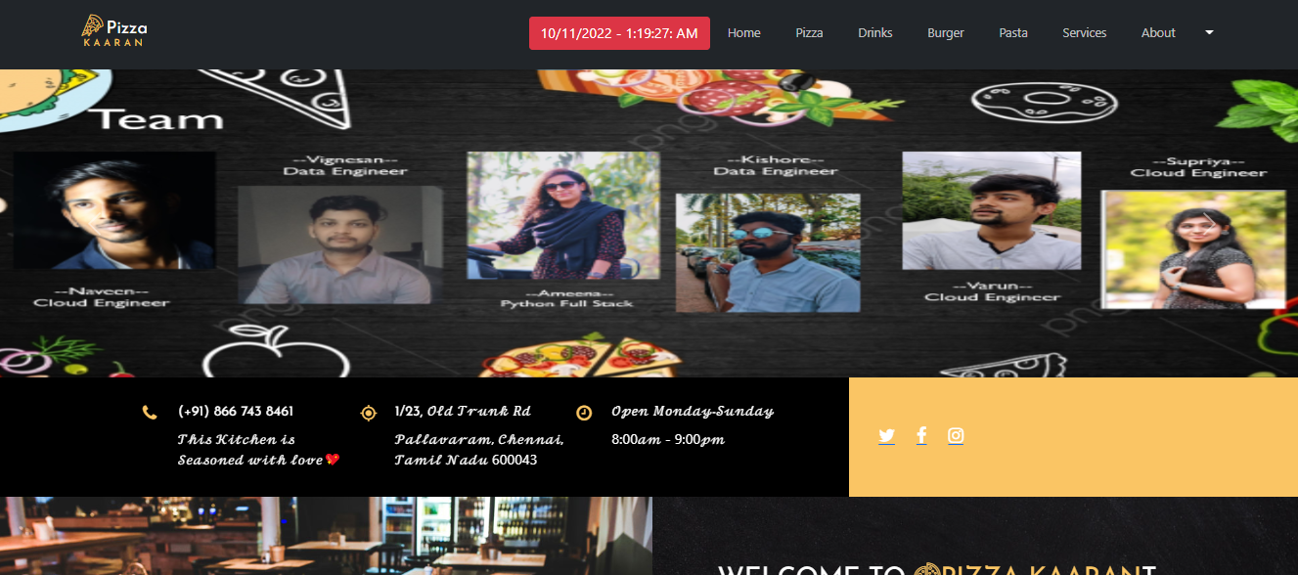
User Interface SCREENSHOTS
SCREENSHOTS
About Page

Slide 35
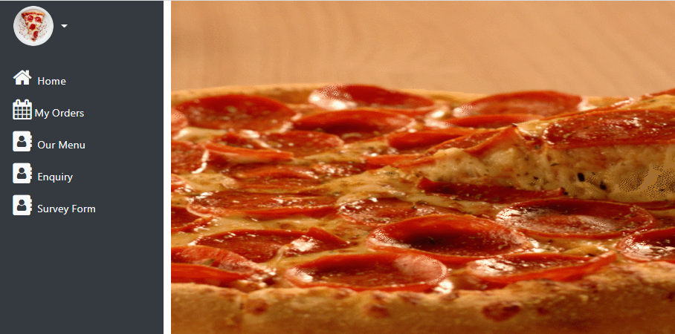
User Interface SCREENSHOTS
SCREENSHOTS
Profile Page

Slide 36
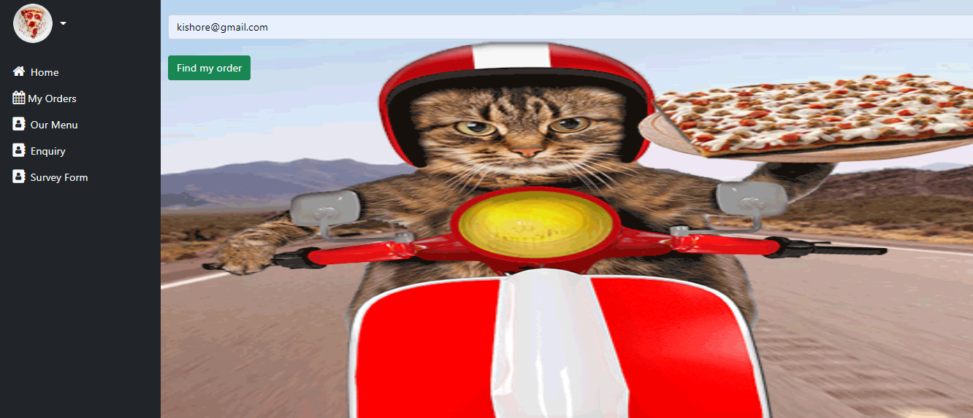
User Interface SCREENSHOTS
SCREENSHOTS
Find Order Page

Slide 37
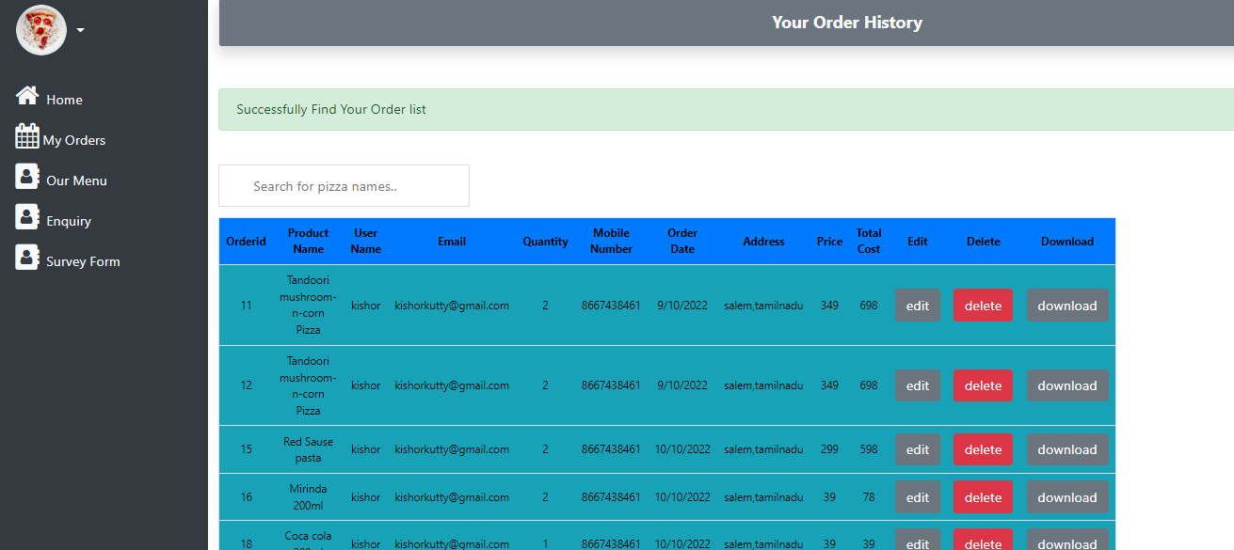
User Interface SCREENSHOTS
SCREENSHOTS
My Order Page

Slide 38
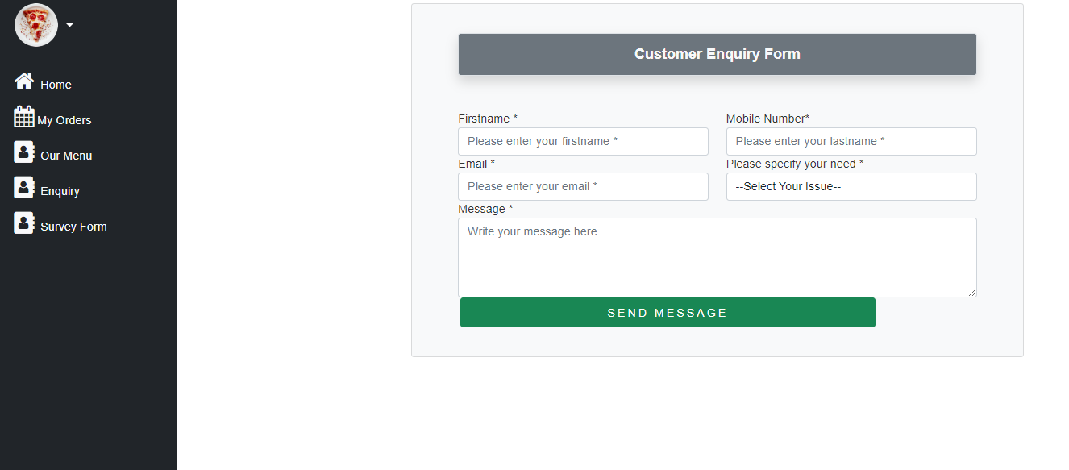
User Interface SCREENSHOTS
SCREENSHOTS
Enquiry Page

Slide 39
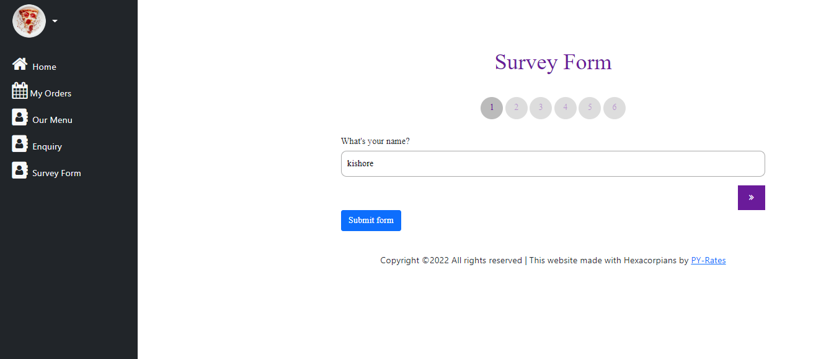
User Interface SCREENSHOTS
SCREENSHOTS
Survey Page

Slide 40
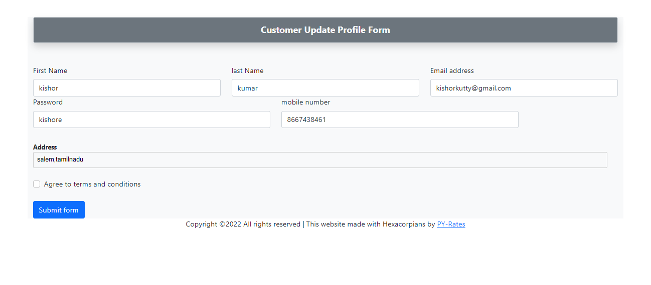
User Interface SCREENSHOTS
SCREENSHOTS
Update Profile Page

Slide 41
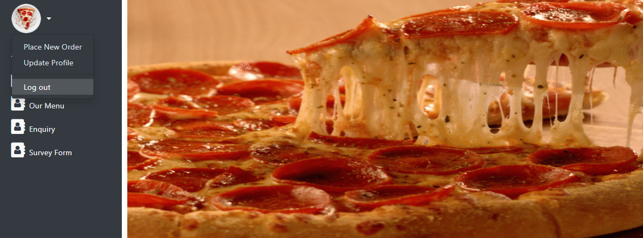
User Interface SCREENSHOTS
SCREENSHOTS
Logout Page

Slide 42
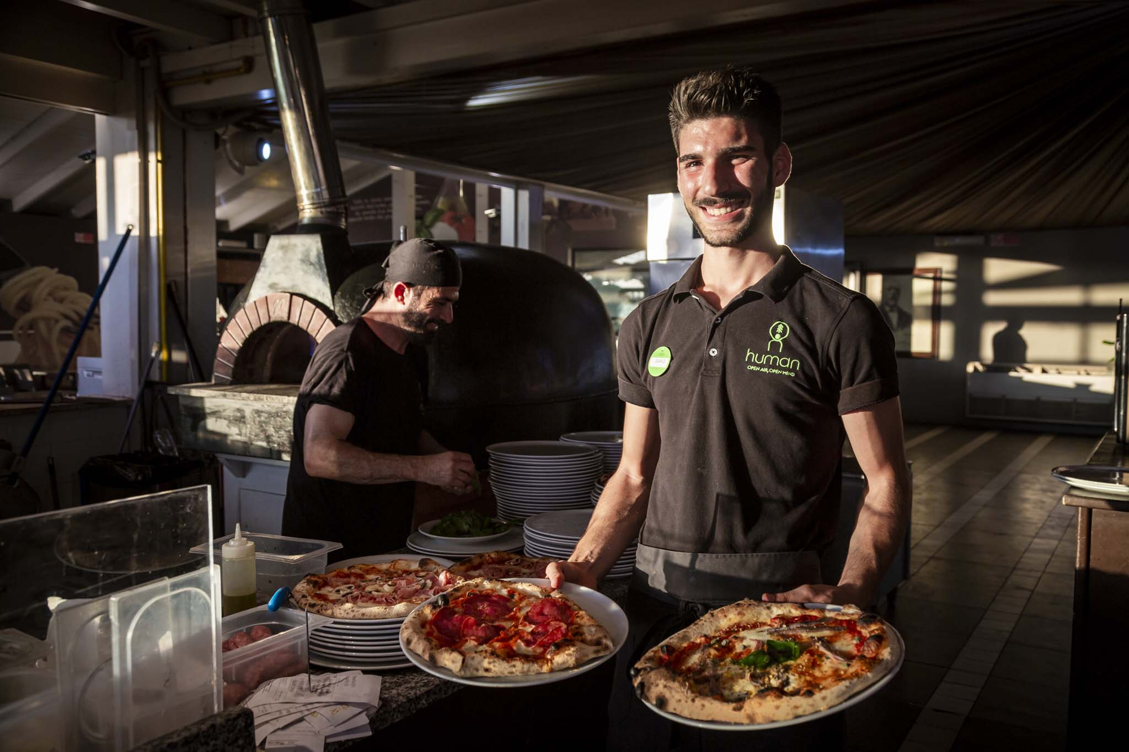
THANK YOU

Slide 43

ALWAYS WELCOMES YOU !!!!!!

